Slide 1
Polarization-Independent Metasurface Lens
Nanophotonics Final Project
Rupin Raj Kumar Pradeep
Notes:
Rachel

Slide 2
The Problem and Proposed Solution
Most metasurfaces require light to be polarized for proper focusing
Solutions already exist using standard Fresnel Zone Plate (FZP), but with low power output
Increase the power output by implementing Binary Phase FZP
Can also increase the number of focal points with Sector Based Binary Phase FZP
Going further:
Adjust plate to focus at a uniform position regardless of incident angle

Slide 3
Contents
Light Polarizations
Fresnel Zone Plate
Sector Based Zone Plate
Binary Phase Fresnel Zone Plate with Nanophotonics
Implementation
Simulation
Results
References

Slide 4
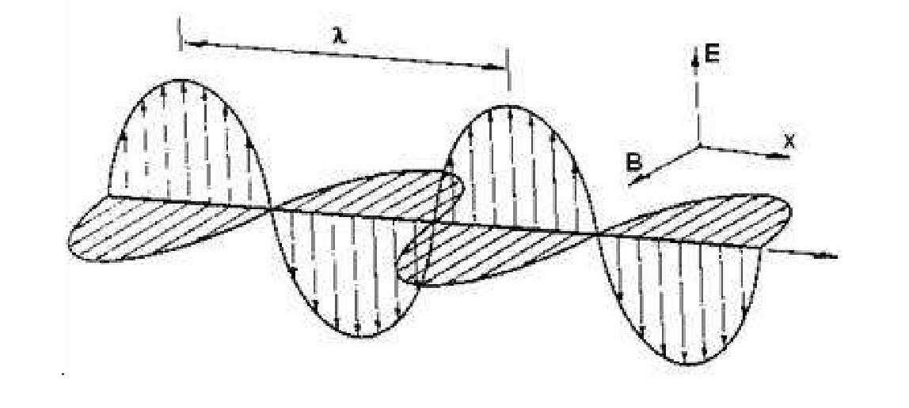
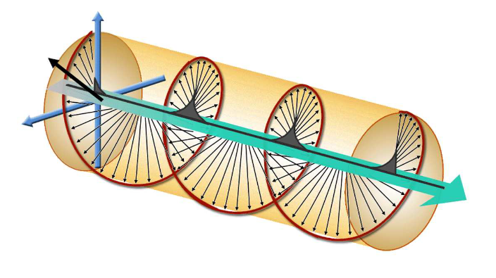
Light Polarizations
2 types of polarizations:
Linearly polarized
Electric field stays in one plane moving on a parallel line
Circular/Helicity polarized
Electric field rotates around the axis line
Two directions, Right Circular Polarized(RCP) and Left Circular Polarized(LCP)
Linearly polarized light has zero helicity
The phase difference between LCP and RCP light is π
Notes:
https://scholar.harvard.edu/files/schwartz/files/lecture14-polarization.pdf

Slide 5
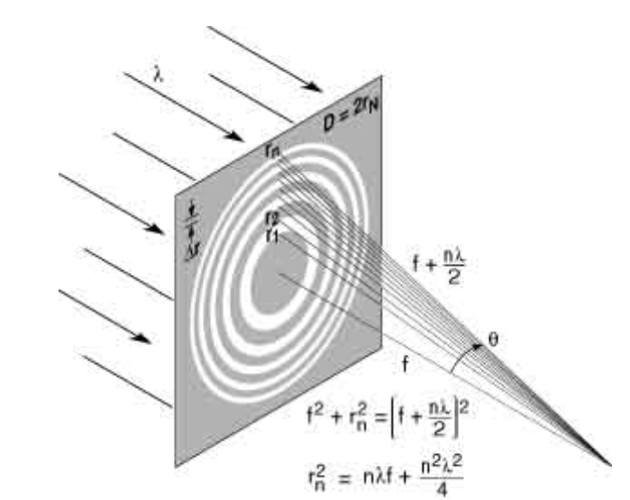
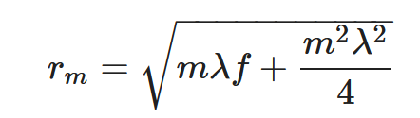
Fresnel Zone Plate
Transparent and opaque bands diffract light around opaque bands to focal center
r_{m} is the inner radius of the mth ring
λ is the wavelength of light
f is the focal distance away from the plate
Every even ring is opaque with the inner circle being ring 0.
Notes:
https://xdb.lbl.gov/Section4/Sec_4-4.html

Slide 6
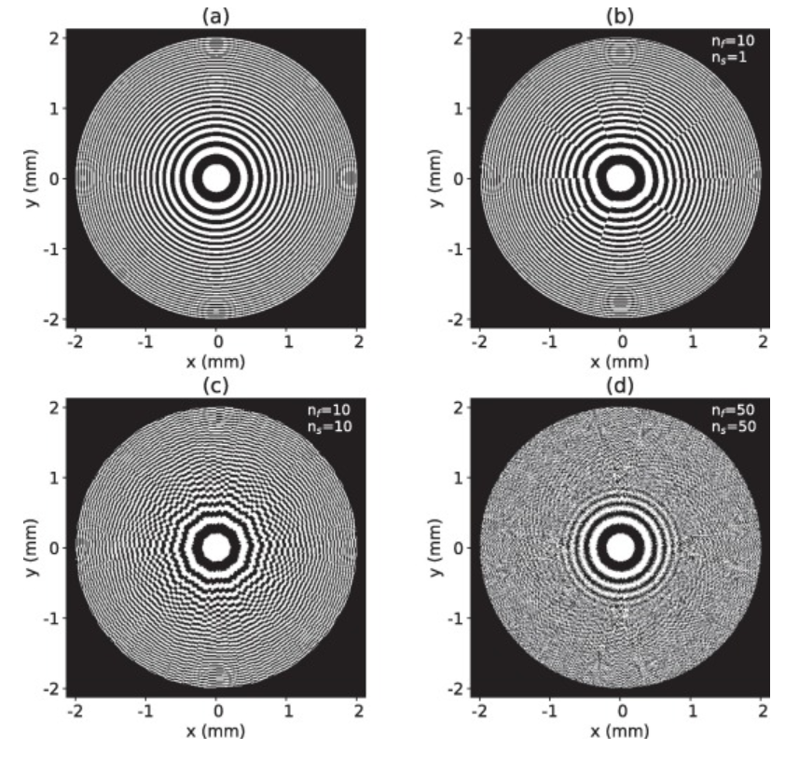
Sector-Based Fresnel Zone Plate
Use sectors to separate the plate and create each sector with different focal length properties
The greater the number of sectors, either increase the number of focal points or the amount of precision
Can also break each sector into separate focal lengths for equal distribution around the plate
Notes:
https://www.sciencedirect.com/science/article/pii/S0030399222004510#f0025

Slide 7
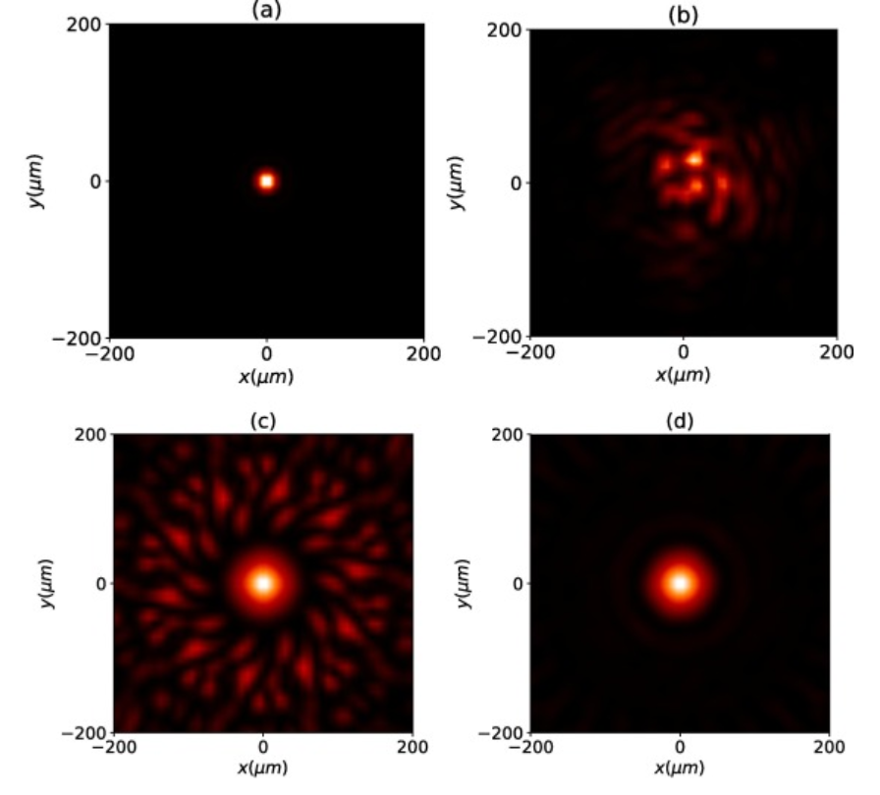
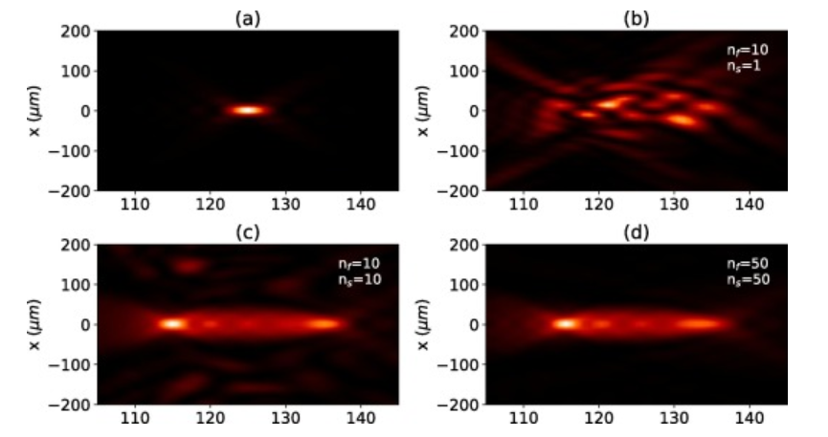
Artifacts
Extended depth of field with more focal points
Notes:
https://www.sciencedirect.com/science/article/pii/S0030399222004510#f0025

Slide 8
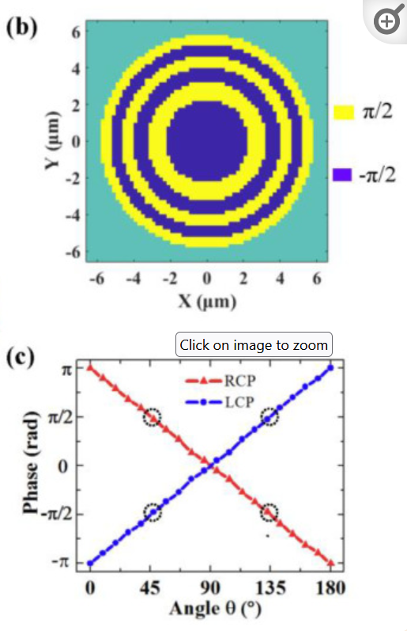
Binary Phase Fresnel Zone Plate in Nanophotonics
Rather than bend using diffraction, we use a metasurface and Generalized Snell’s Law
Binary phase means change transparent band to π/2 rotation and opaque band to -π/2 rotation
Both bands now “diffract” light
Use angles of 45º and 135º
At 45º: RCP -> RCP + π/2 & LCP -> LCP - π/2
Then RCP = LCP with π phase difference
At 135º: RCP -> RCP - π/2 & LCP -> LCP + π/2
Again, RCP = LCP with π phase difference
Notes:
https://www.ncbi.nlm.nih.gov/pmc/articles/PMC7466408/

Slide 9
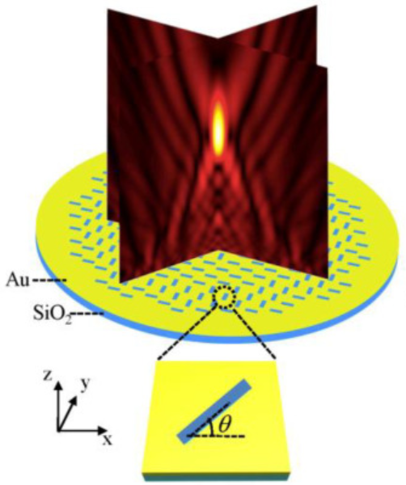
Implementation
Monitor in the z direction with focal point here
Gold plate with slits on silicon glass
Slits: L=50nm W=180nm T = 100nm
Diameter of lens = 11um
Separation of 200nm between slits to prevent coupling between slits
Therefore, there are 3 +π/2 and 3 -π/2 bands
Light (plane wave source) comes from the bottom (glass/substrate side)
Adjustable slit separation for multiple focal points
Depth of focal point
Notes:
https://www.ncbi.nlm.nih.gov/pmc/articles/PMC7466408/

Slide 10
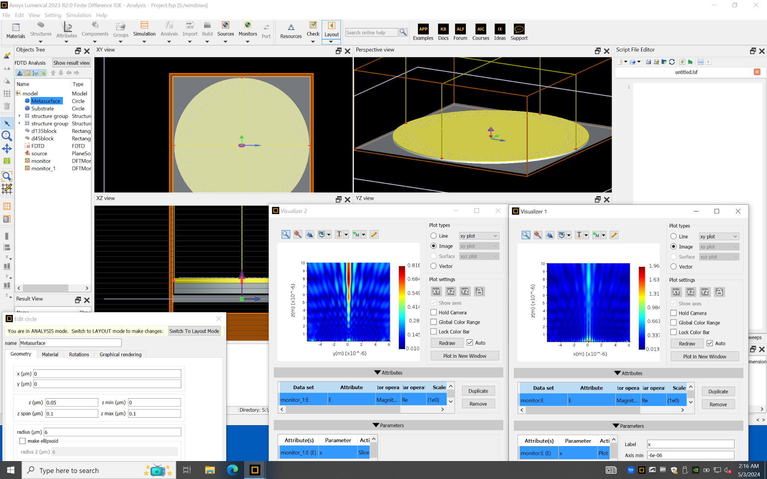
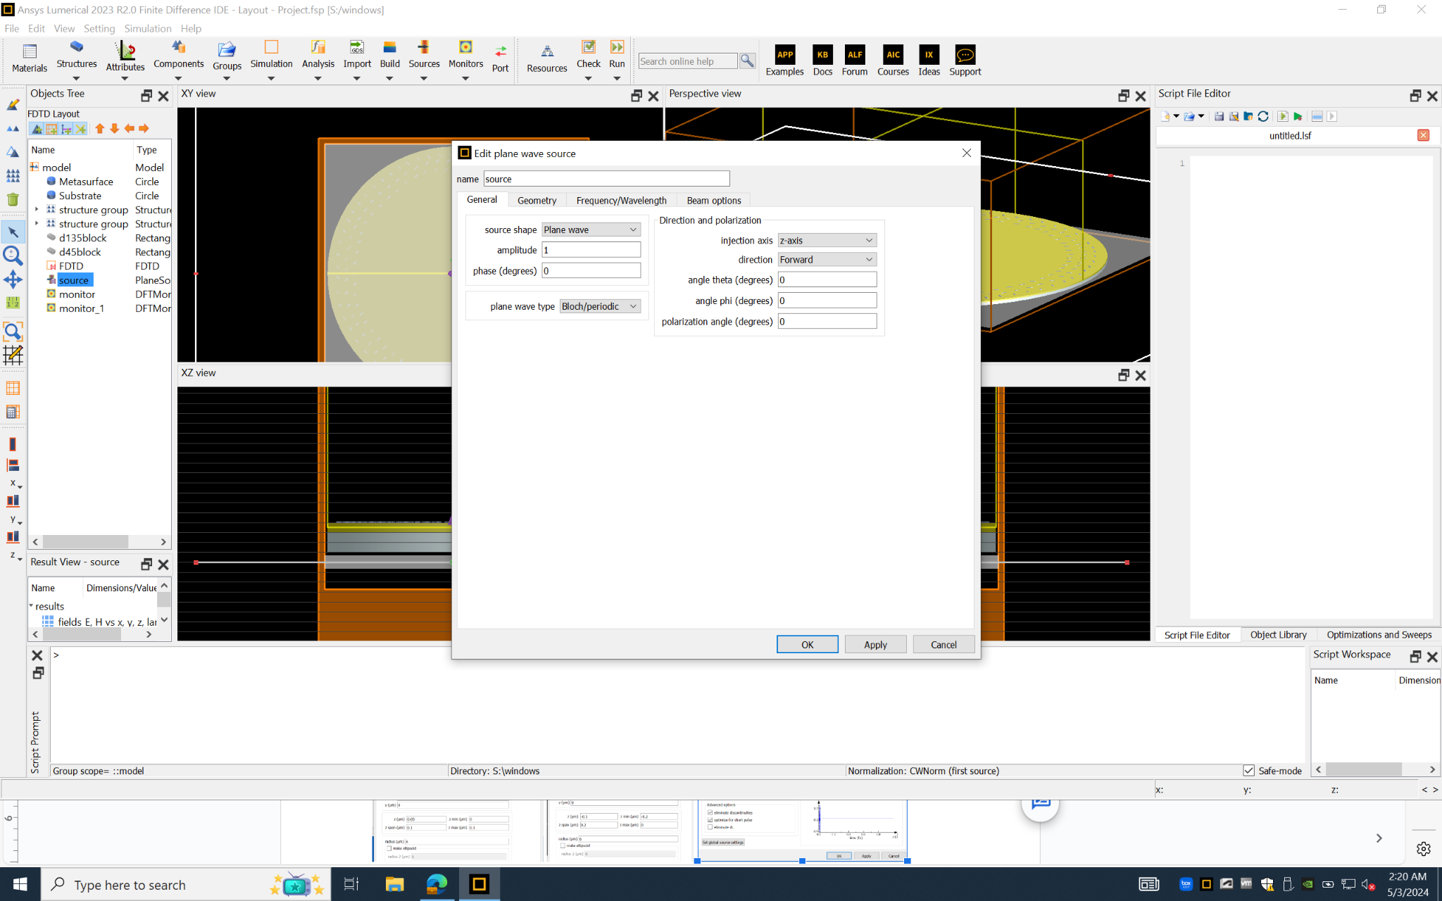
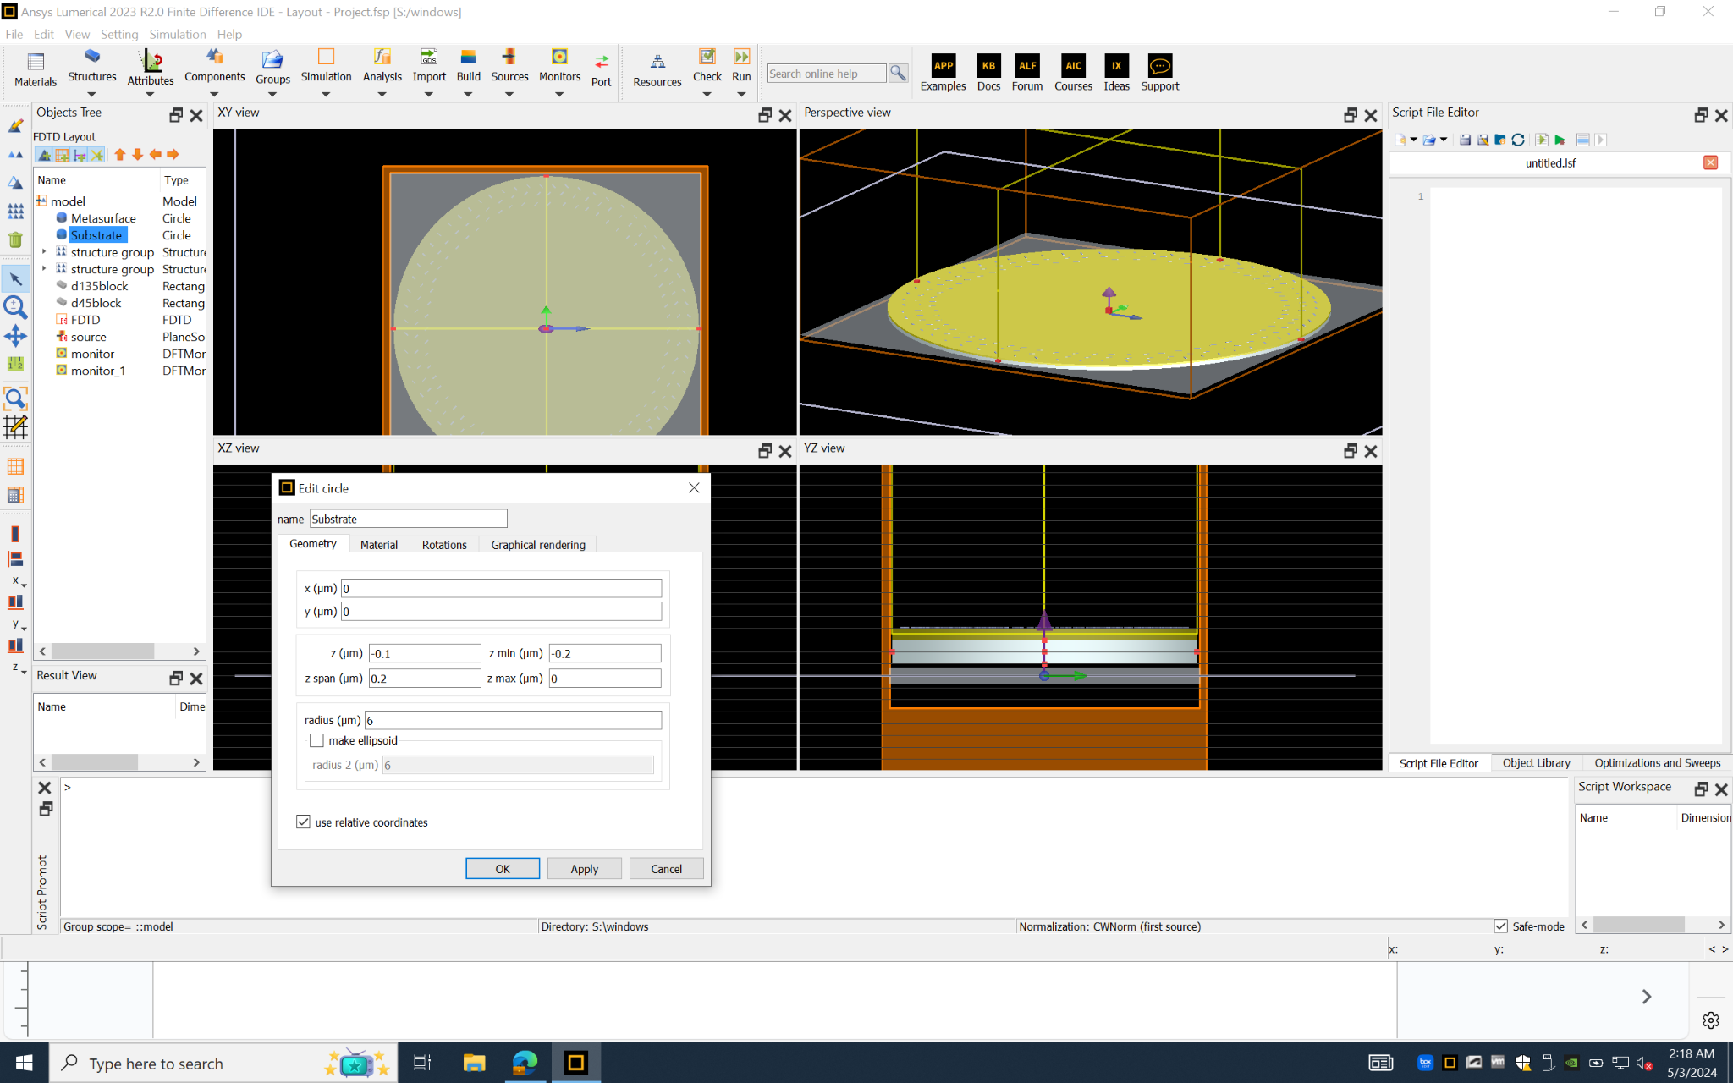
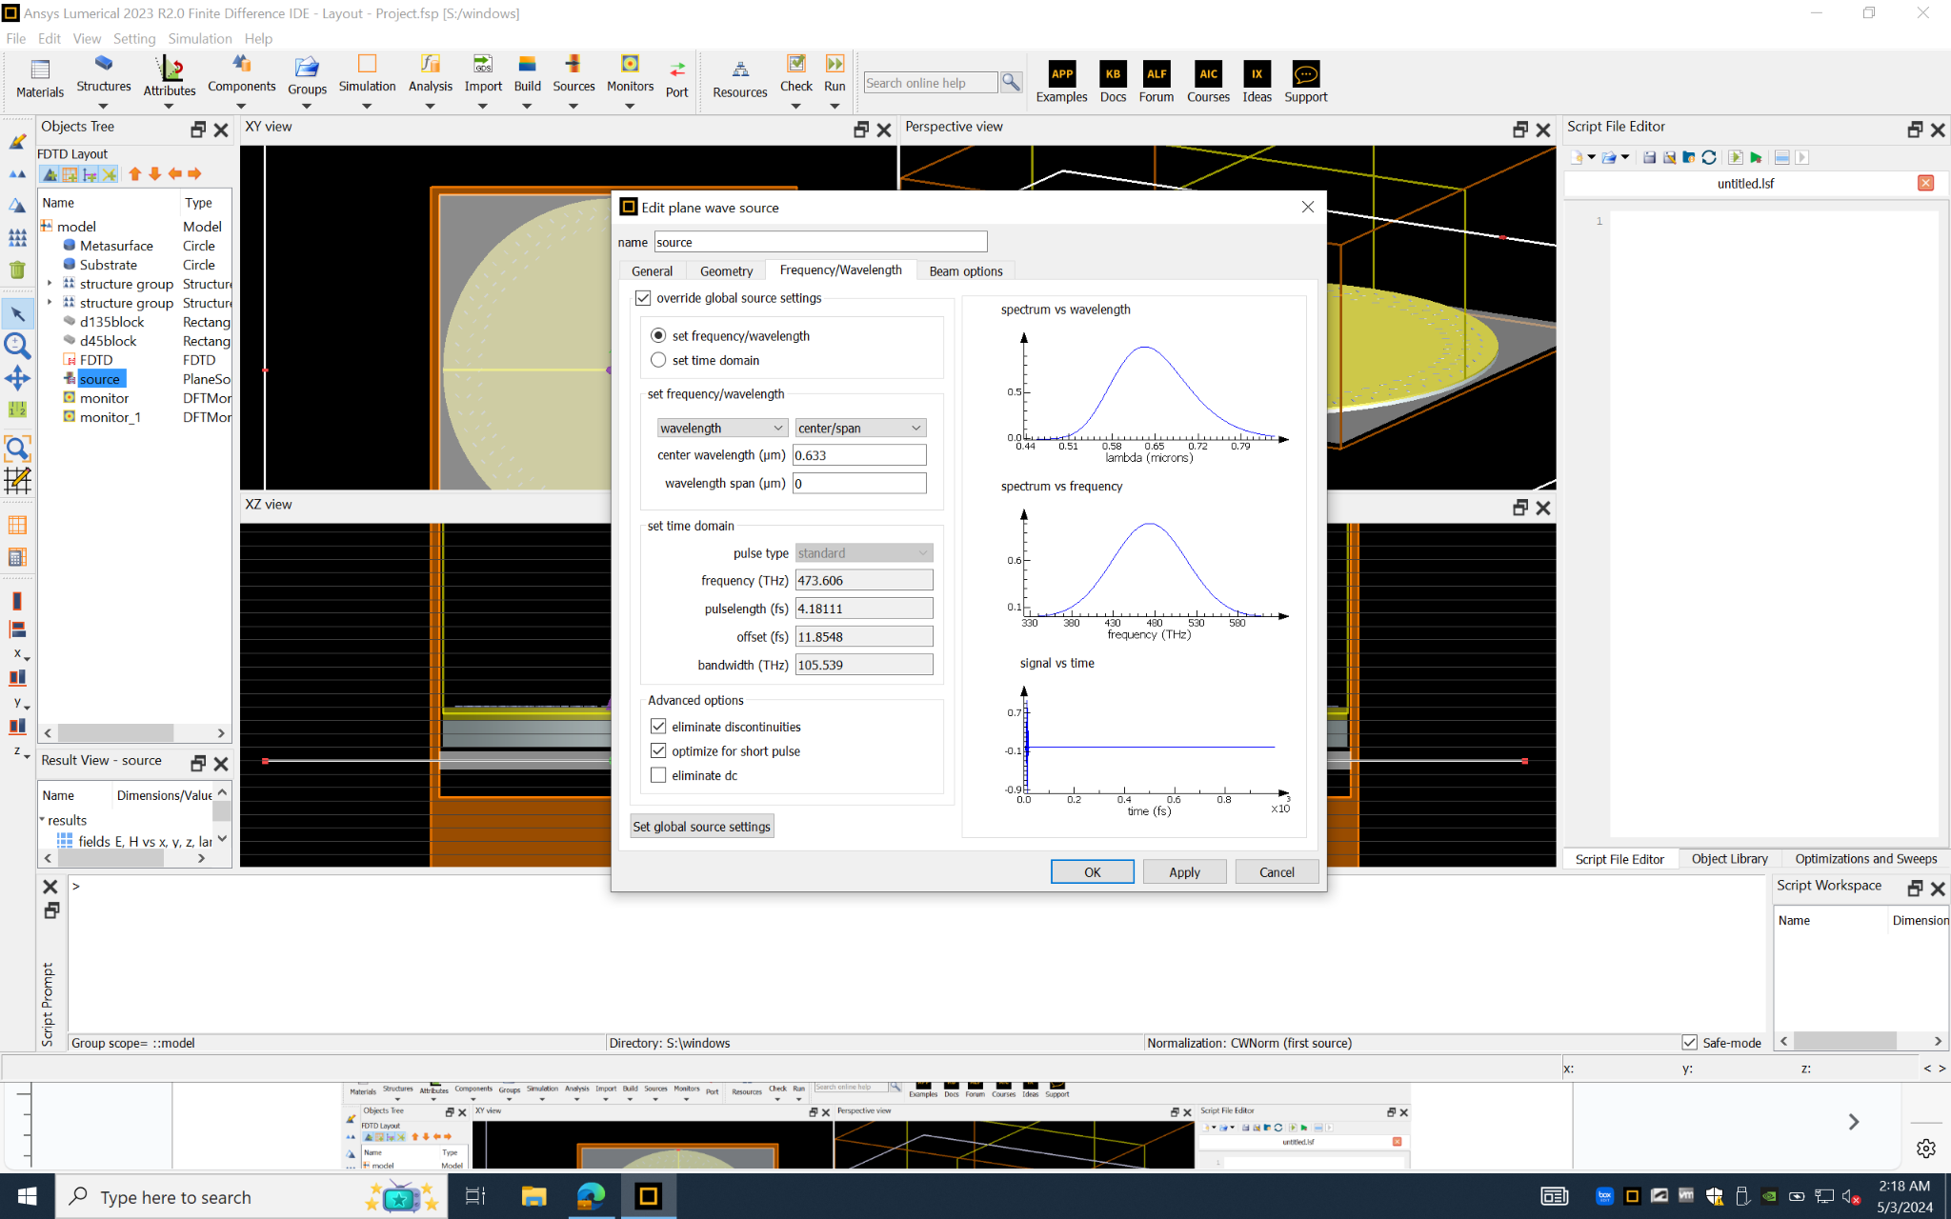
Simulation Settings
Testing 633 nm wavelength, focal distance 8um.
90
Notes:
https://xdb.lbl.gov/Section4/Sec_4-4.html

Slide 11
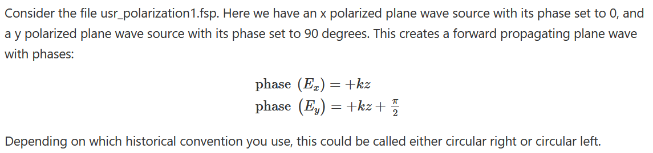
Simulation Settings
90
Notes:
https://xdb.lbl.gov/Section4/Sec_4-4.html

Slide 12
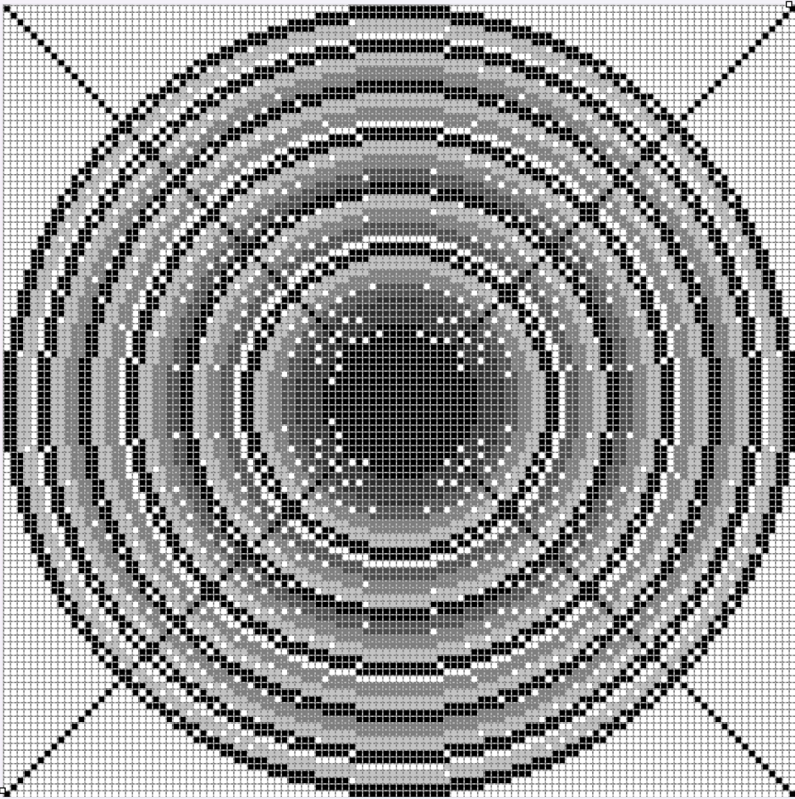
Simulation Design
2 rows
in layer
1 row
in layer
3 rows
in layer
Accurate
Inaccurate
Notes:
https://xdb.lbl.gov/Section4/Sec_4-4.html

Slide 13
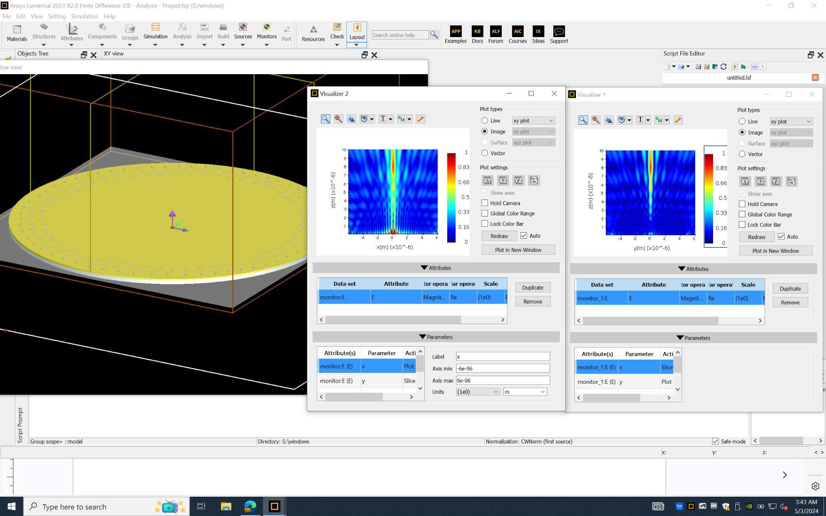
Simulation - 2 of 6 Circles
Notes:
https://xdb.lbl.gov/Section4/Sec_4-4.html

Slide 14
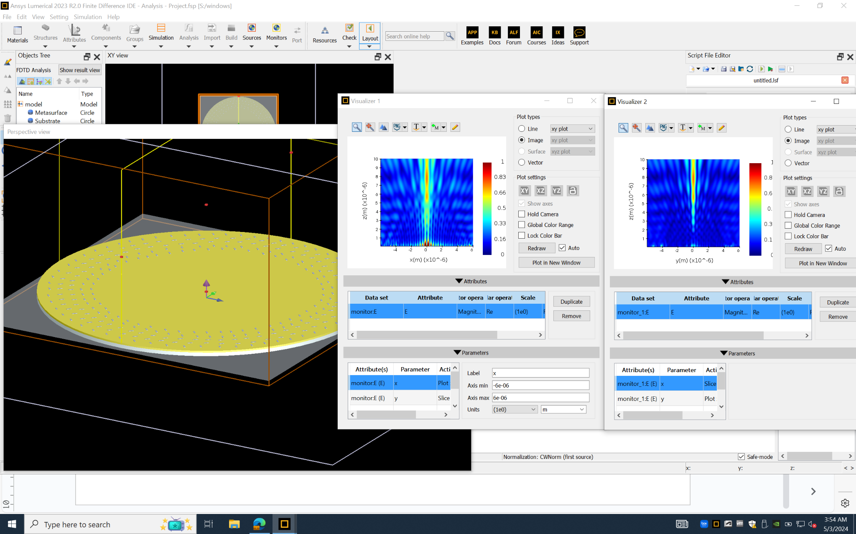
Simulation - 3 of 6 Circles
Notes:
https://xdb.lbl.gov/Section4/Sec_4-4.html

Slide 15
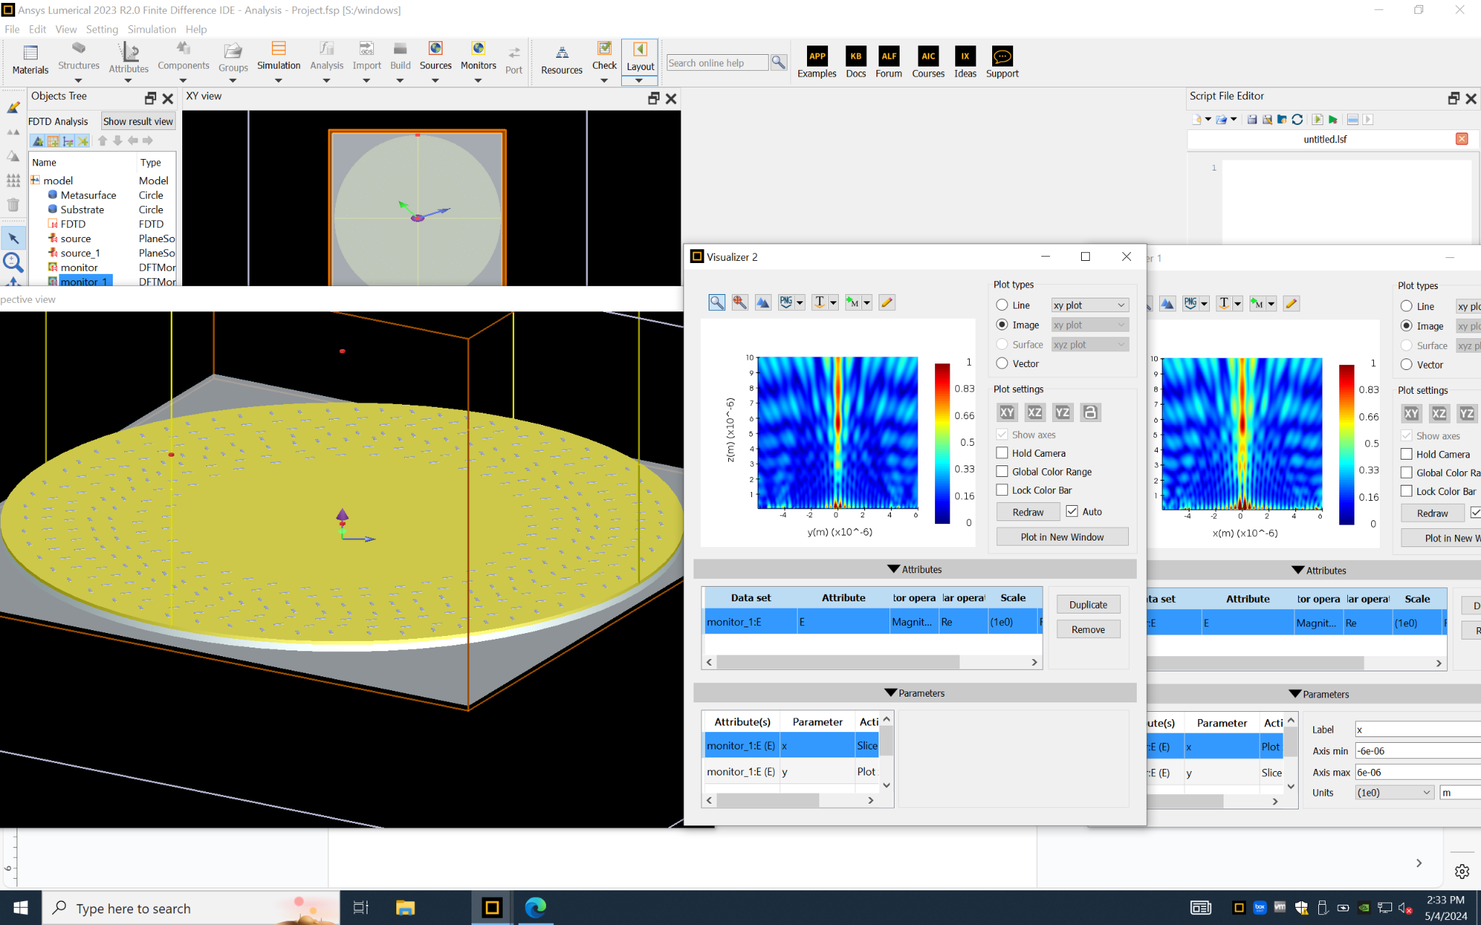
Simulation - 4 of 6 Circles
Notes:
https://xdb.lbl.gov/Section4/Sec_4-4.html

Slide 16
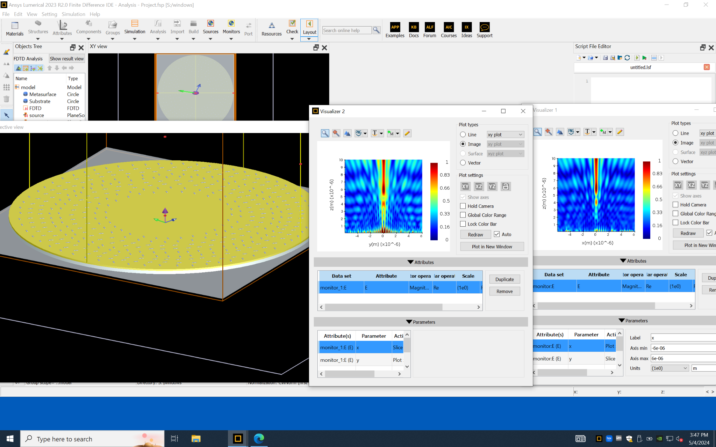
Simulation - 5 of 6 Circles
Notes:
https://xdb.lbl.gov/Section4/Sec_4-4.html

Slide 17
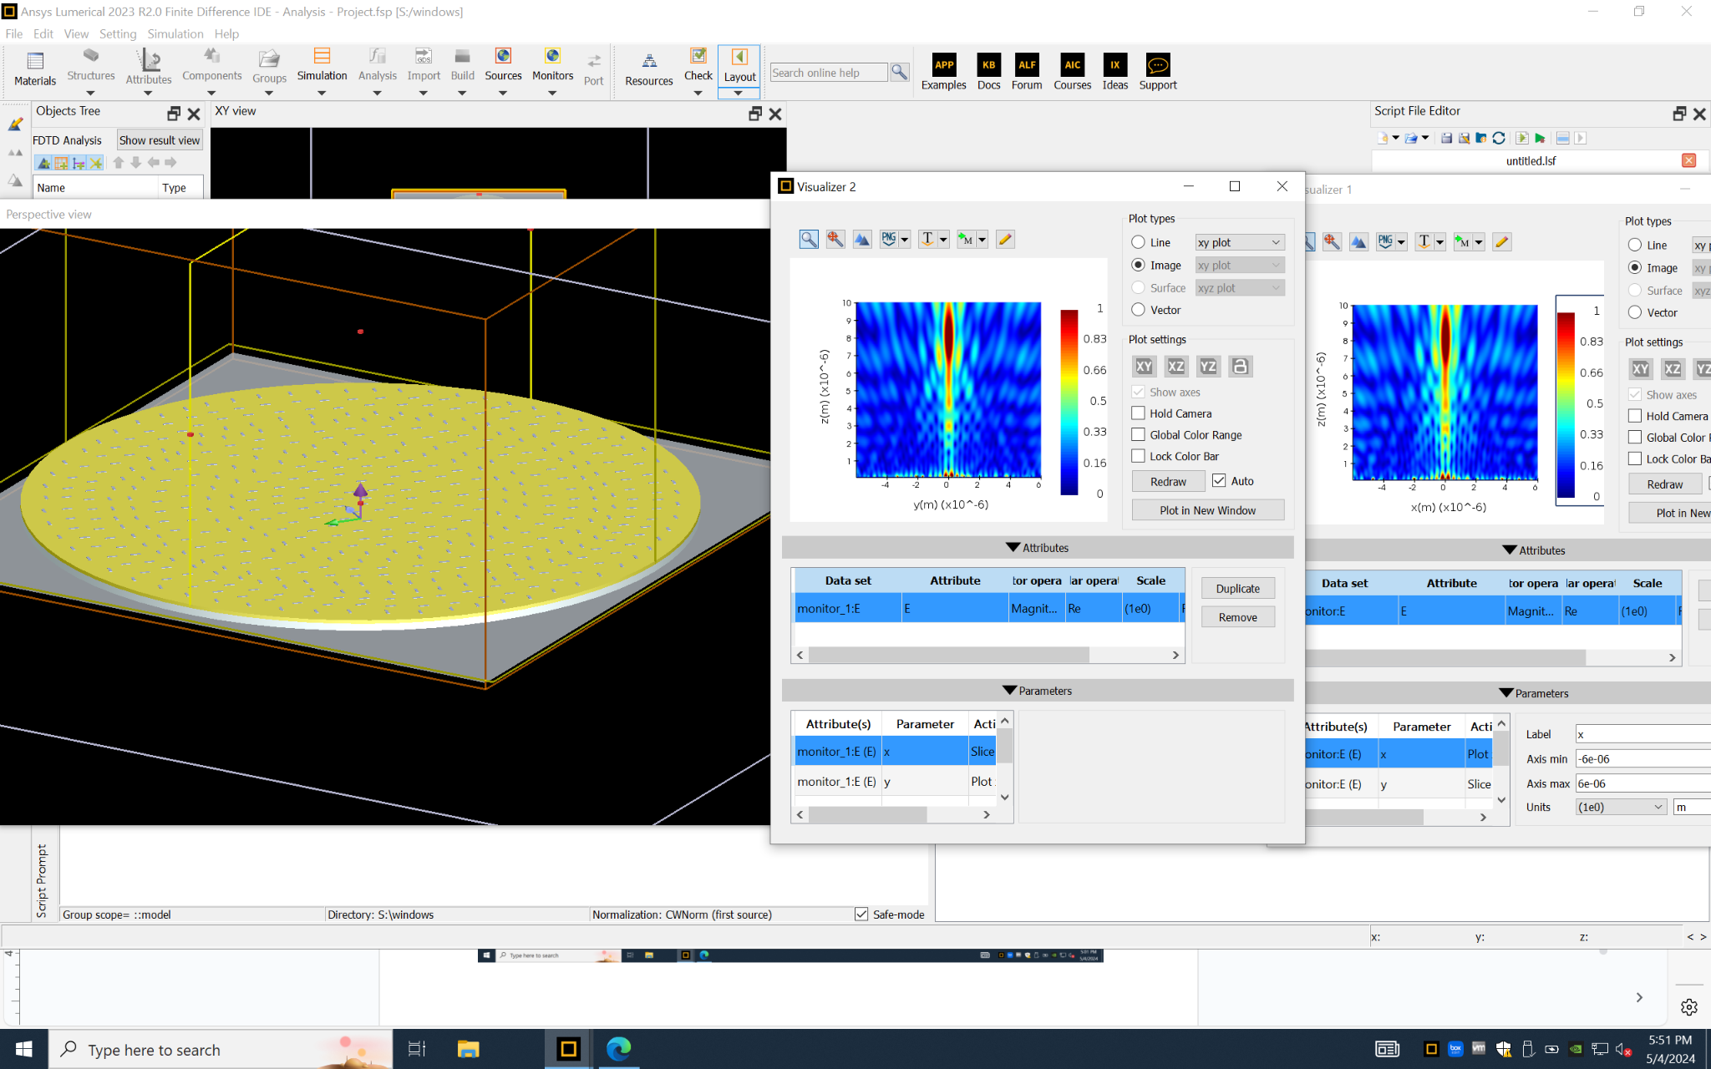
Simulation - All Circles
Notes:
https://xdb.lbl.gov/Section4/Sec_4-4.html

Slide 18
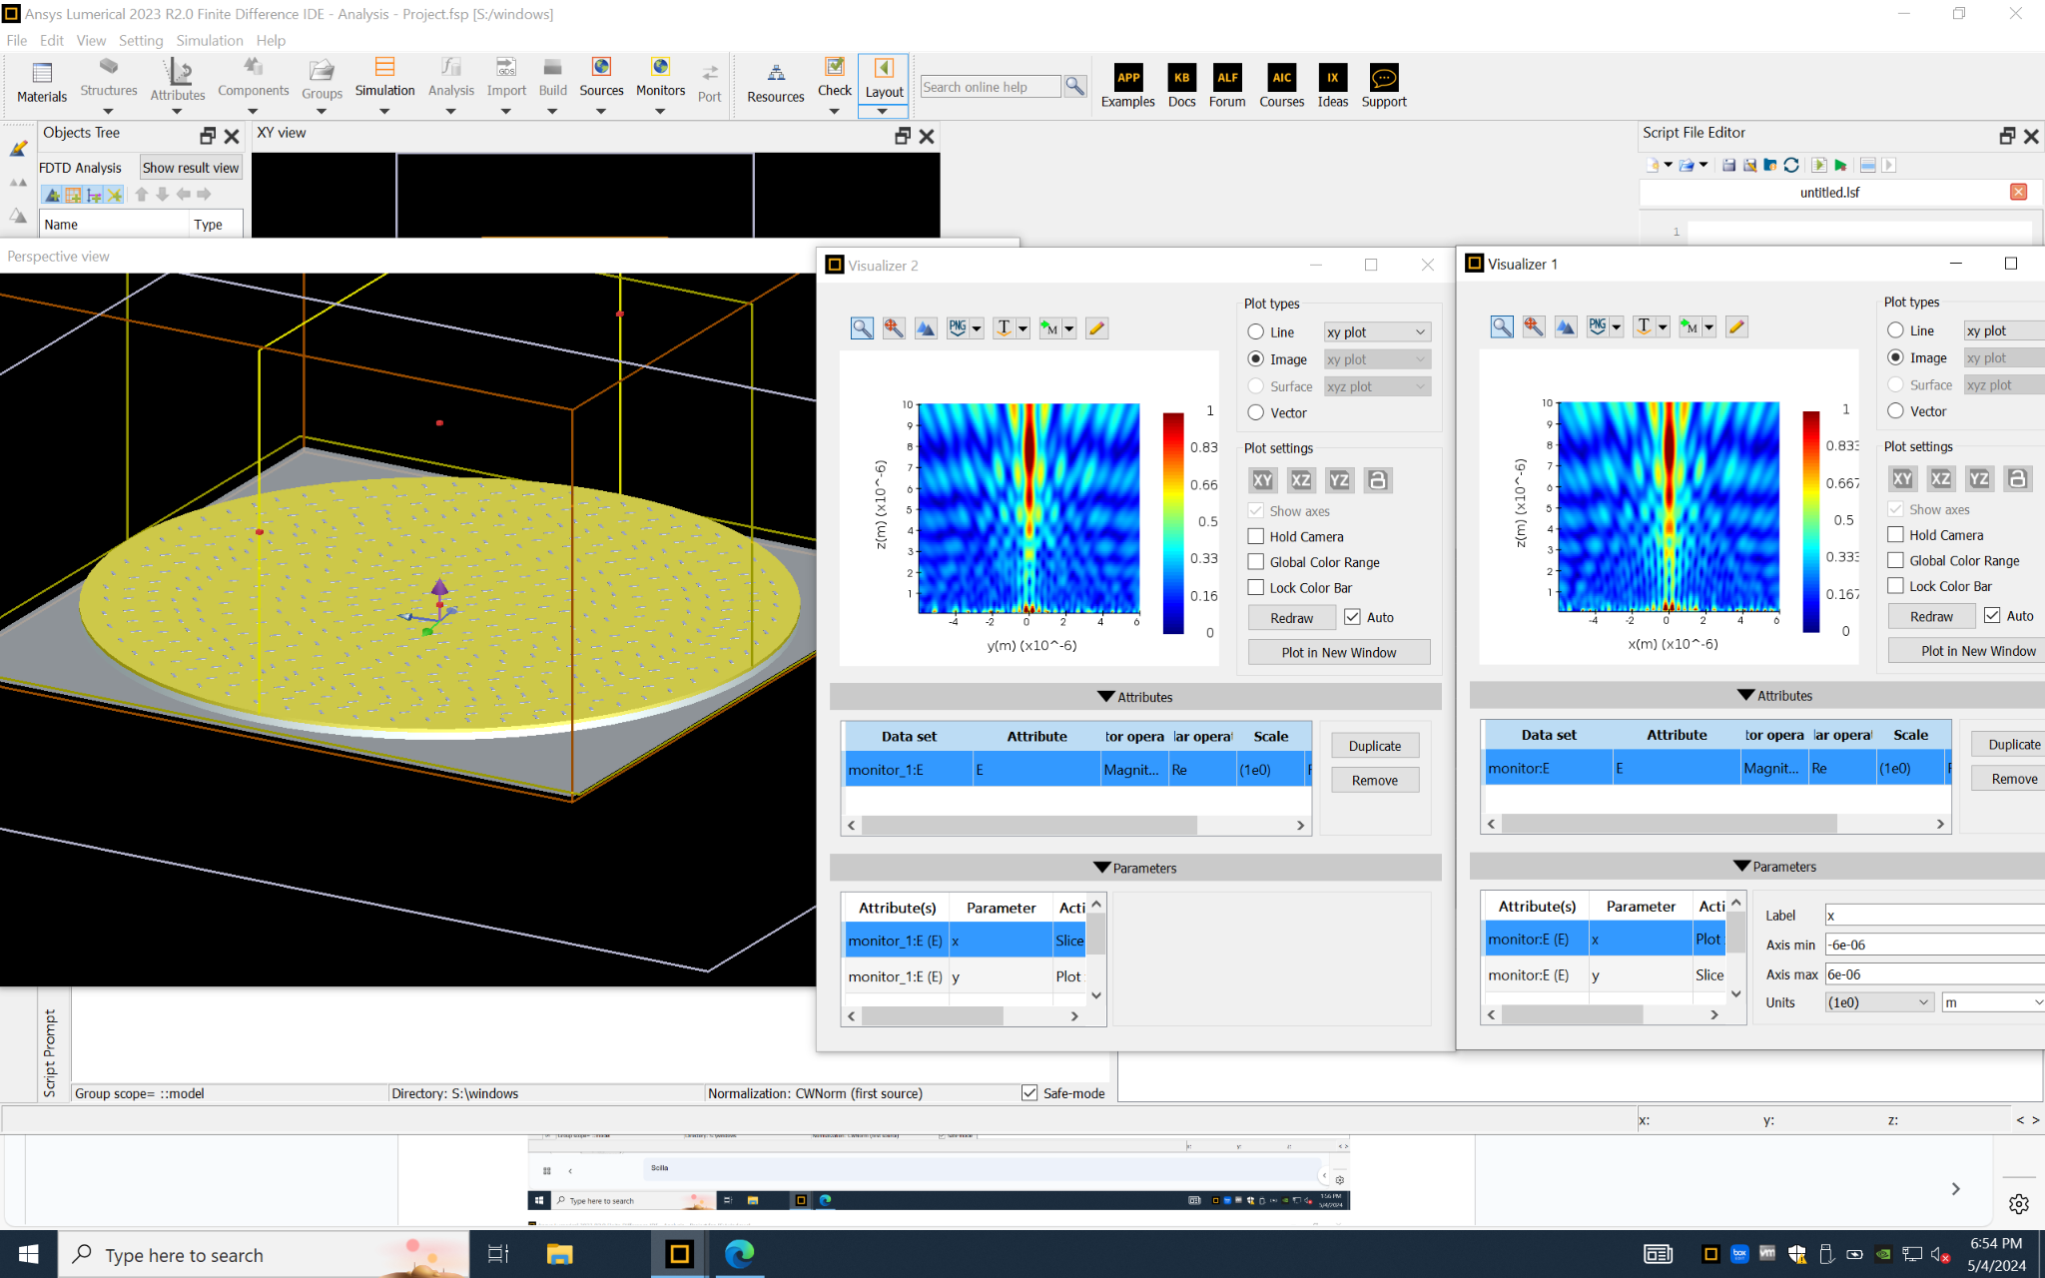
Simulation - All Circles
Notes:
https://xdb.lbl.gov/Section4/Sec_4-4.html

Slide 19
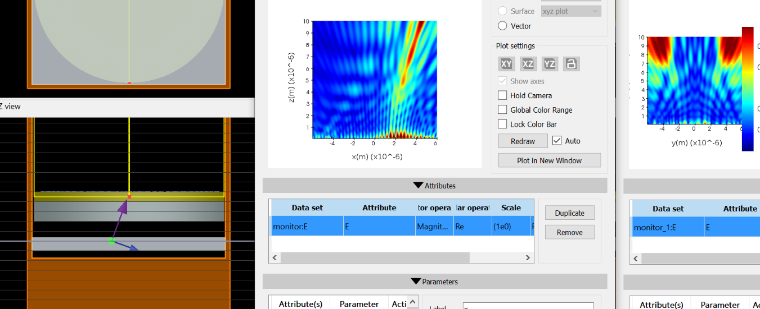
Simulation - Changing angle of incidence
Notes:
https://xdb.lbl.gov/Section4/Sec_4-4.html

Slide 20
Results
Increasing the number of circles going inward
increases electric field strength at convergence
Placement error and lack of slits
larger error in convergence point
Changing polarization only very slightly changes output
Changing angle of incidence
generally has convergence at the same distance, just in the direction of incidence
Notes:
https://xdb.lbl.gov/Section4/Sec_4-4.html

Slide 21
References
Article Chosen:
https://www.ncbi.nlm.nih.gov/pmc/articles/PMC7466408/
Supporting Resources:
https://scholar.harvard.edu/files/schwartz/files/lecture14-polarization.pdf
https://www.sciencedirect.com/science/article/pii/S0030399222004510
https://xdb.lbl.gov/Section4/Sec_4-4.html

